Slide 1
Object Oriented Programming

Slide 2
What is OOP?
Object-oriented programming (OOP) is a programming paradigm based on the concept of objects which may contain data in the form of fields often known as attributes.
It is a program has been viewed as a logical procedure that takes input data, processes it, and produces output data.

Slide 3
Feature of OOP
Programs are divided into entities known as objects.
Data Structures are designed such that they characterize objects.
Functions that operate on data of an object .
Data is hidden and cannot be accessed by external functions.
Objects communicate with each other through functions.
Follows bottom up design in program design.
New data and functions can be easily added whenever necessary.

Slide 4
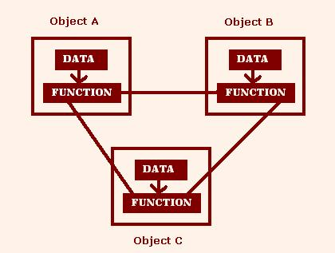
Diagram of OOP

Slide 5
OOP Elements
There are Eight basic elements in Object oriented Language as :
Object
Class
Data Abstraction
Encapsulation
Data Hiding
Inheritance
Polymorphism
Dynamic Binding

Slide 6
Continue…..
Object :- Any entity that has state and behavior is known as an object. They are the basic elements of object Oriented system .For example: chair, pen, table, keyboard, bike etc. It can be physical and logical.
Class :- Collection of objects is called class. It is a logical entity. class is a group of objects which posses same attributes and behavior.

Slide 7
Continue…..
Data Abstractio n :- Hiding internal details and showing functionality is known as abstraction. For example:- phone call, we don’t know the internal processing.
Encapsulation :- Binding (or wrapping) code and data together into a single unit is known as encapsulation.
For example: capsule, it is wrapped with different medicines. A java class is the example of encapsulation.

Slide 8
Continue……
Data Hiding :- It is mainly to hide internal object details the design decisions in a computer program that are most likely to change.
Inheritance :- When one object acquires all the properties and behaviors of parent object i.e. known as inheritance. It provides code re usability .
Reusability means the class is completed and tested then it can be distributed to other programmers for use their own.

Slide 9
Continue……
Polymorphism :- When one task is performed by different ways known as polymorphism. For example: to convense the customer differently, to draw something .Ex-shape or rectangle etc.
Dynamic Binding :- Dynamic binding is the process of linking procedure call to a specific sequence of code (method) at run-time .It means that the code to be executed for a specific procedure call.

Slide 10
THANK YOU

